Slide 1

Searching of Information workshops series on Information literacy for higher education
A.V. Muditha Ankumbura
Senior Assistant Librarian
University of the Visual and Performing Arts

Slide 2




Information Sources
People
Books, journals, News papers
Internet
Library and Information centres

Slide 3


Slide 4
Searching Information from books
How to read a book
There are several types of reading methods.
1 Word by word
Word by word is how you read something you find that interests (Fiction, Novel)
2 Reading to study
Reading only selected part of a book
3 Skimming
reading quickly to get idea without reading whole detail (Poster)
4 Scanning
Scanning is usually what you do while reading the newspaper since it's impossible to read the entire thing.
5 Light reading
Reading to select a book
For more information on types of reading visit: ababasoft.com.

Slide 5

Part of a book
Cover page
Title page
Content page
Text
Bibliography

Slide 6


Cover Page

Slide 7
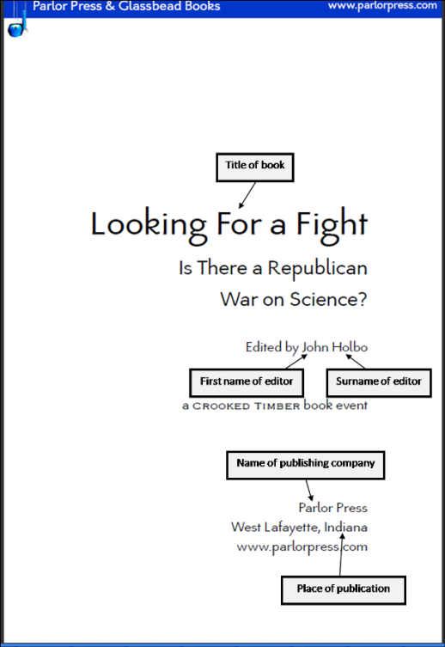
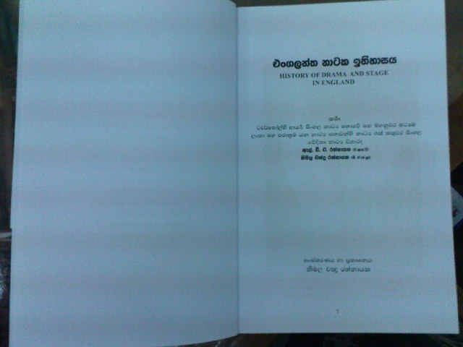
Title Page

Slide 8
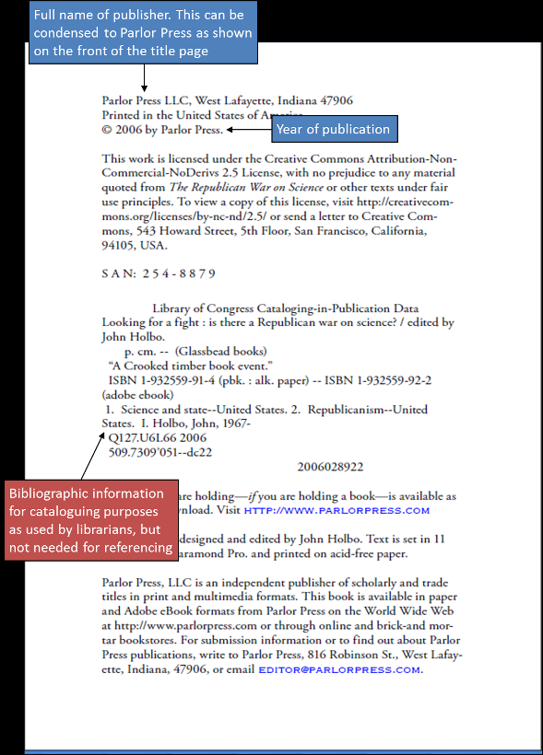

Slide 9
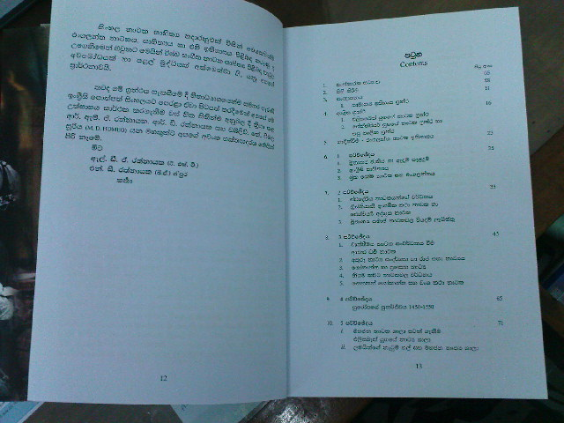
Content Page

Slide 10
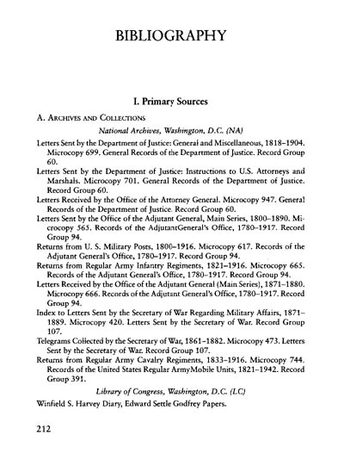
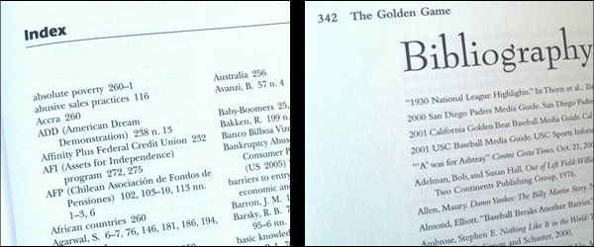
Bibliography and index

Slide 11

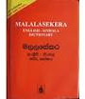


Reference sources - Dictionaries

Slide 12



Slide 13
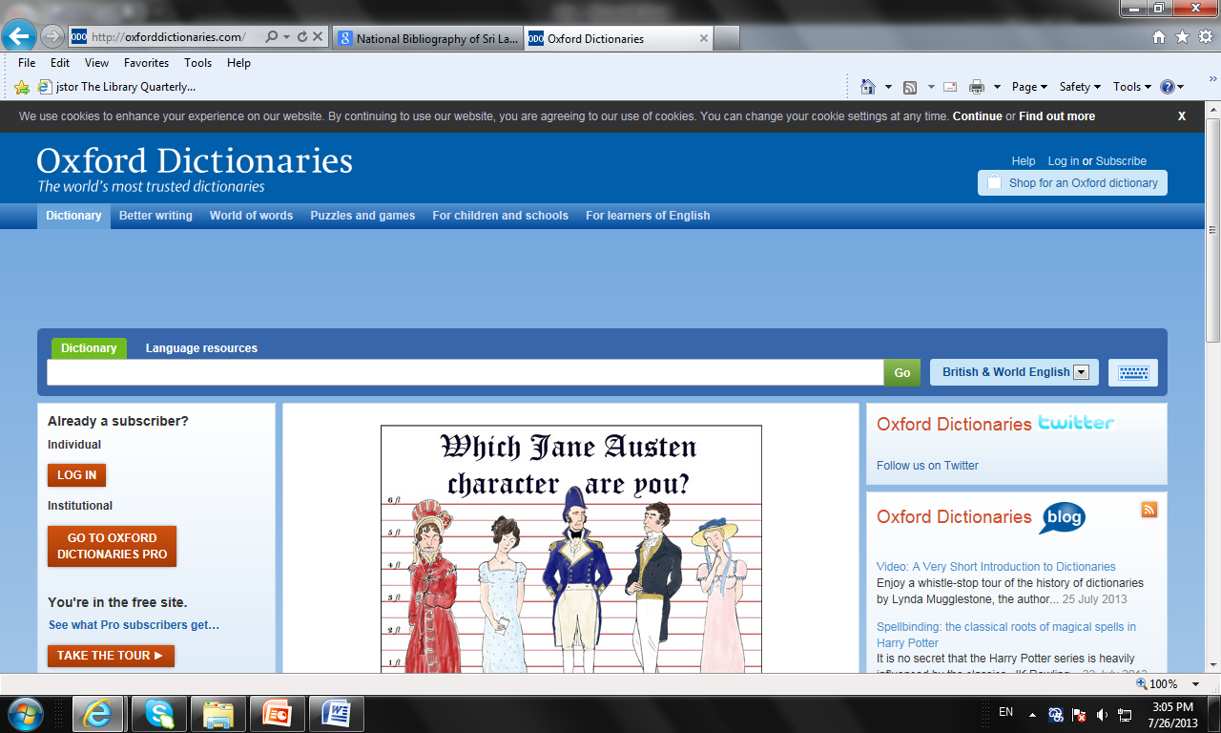

Slide 14
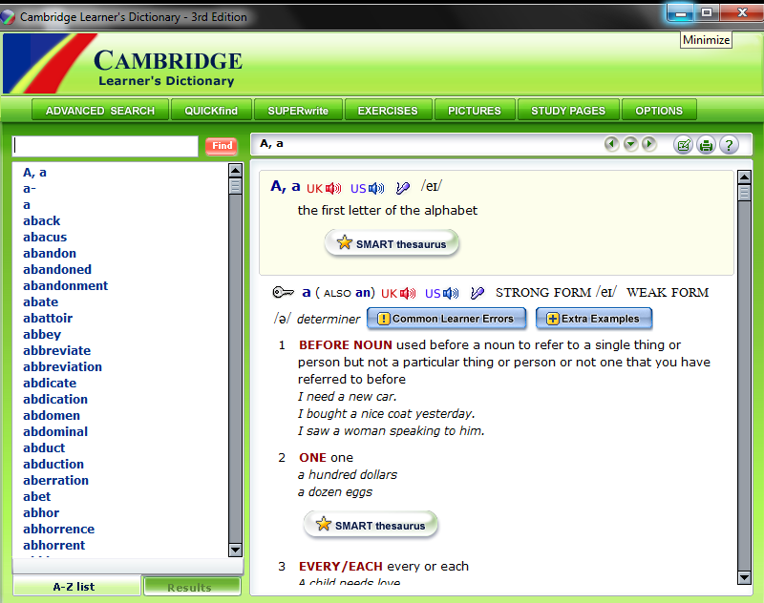

Slide 15


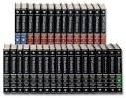
Encyclopedias

Slide 16
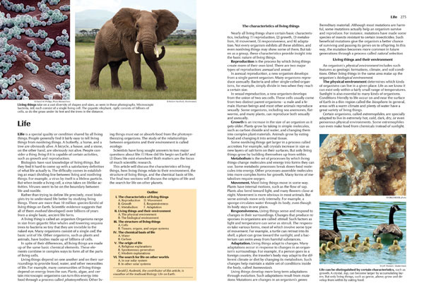
What are in Encyclopedia

Slide 17
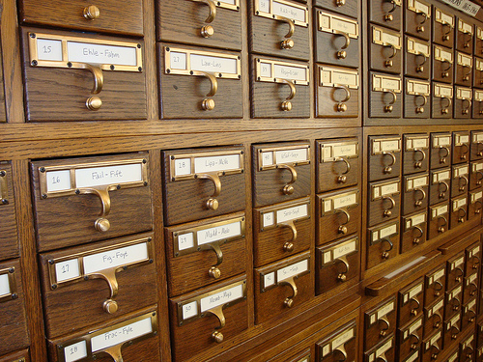

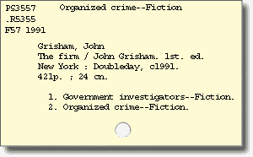

Library Catalogues

Slide 18
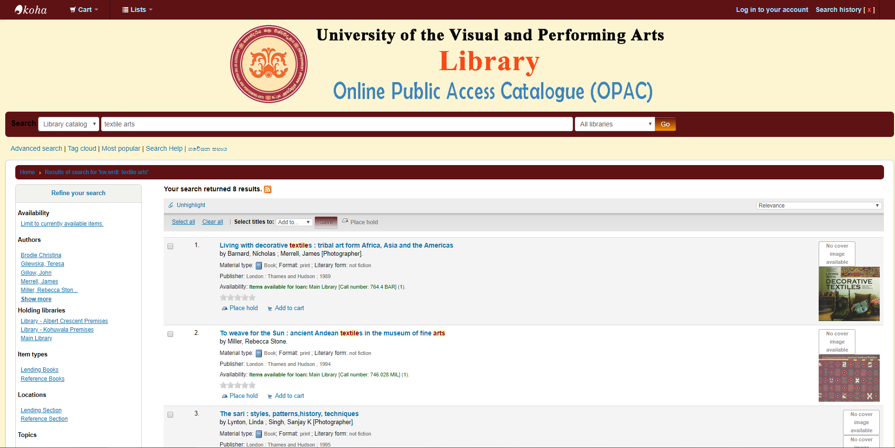
Electronic Catalogue
http://catalog.loc.gov/
http://infosys.lib.vpa.ac.lk/

Slide 19
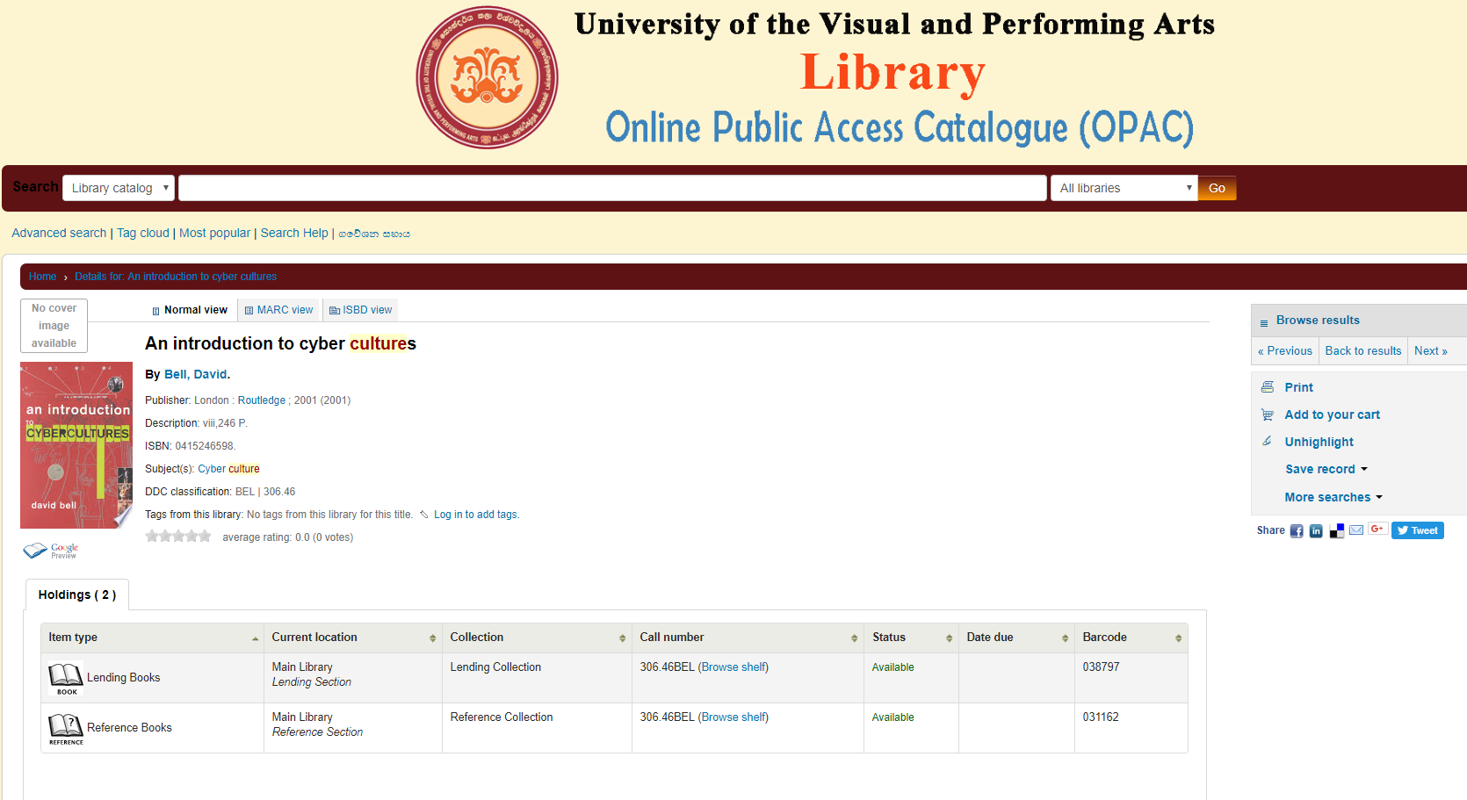
Browsing your online catalogue

Slide 20
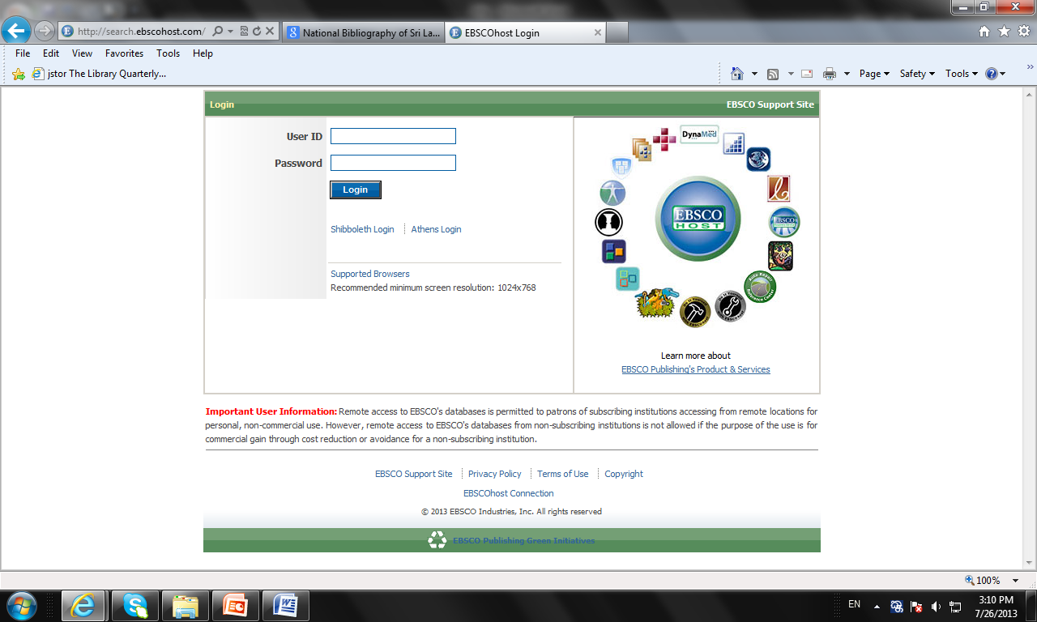
Data bases
http://search.ebscohost.com/
http://www.jstor.org/discover/

Slide 21

how search correct source…..?

Slide 22
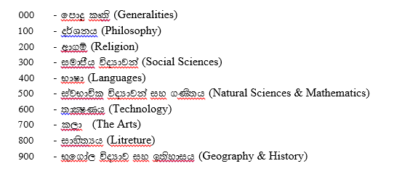
Library classification

Slide 23
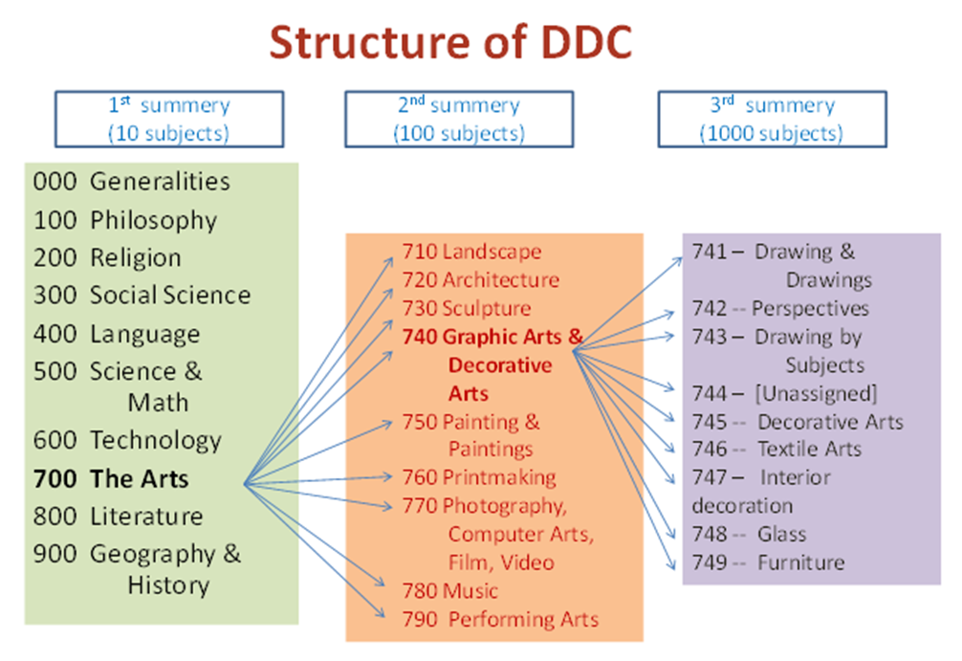
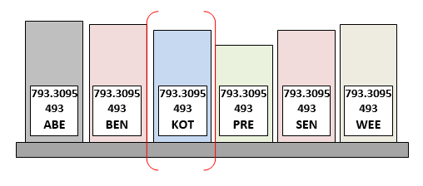
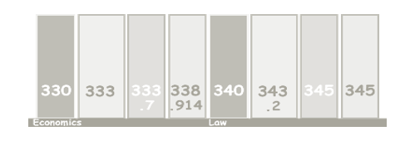
Library classification

Slide 24
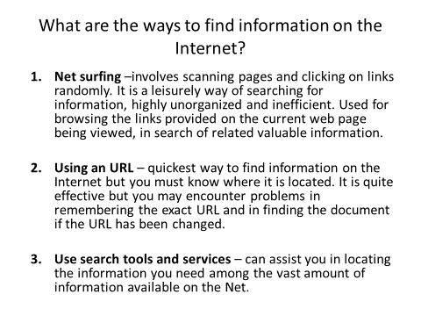
Searching on the internet

Slide 25
What are the Internet search tools and services?
General classifications of Internet tools and services available through the World Wide Web (www):
Search engines
Subject directories
Invisible Web
Other search tools

Slide 26
How to Search the Internet ?
Generally there are two ways of using search tools and services
1. Browsing
–usually applied to directories where subjects are arranged hierarchically
2. Keyword search
– search box is provided for entering keywords to search the database
Simple search – search on the keywords
Advanced search - search can be refined using various techniques

Slide 27
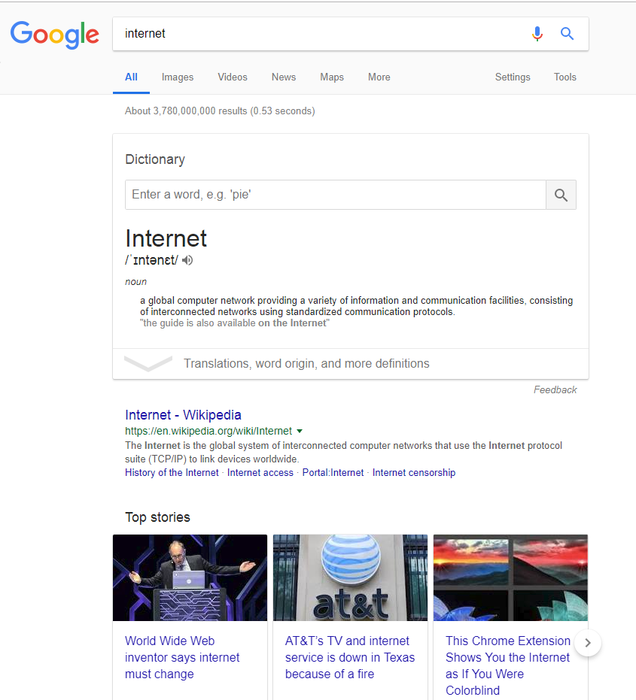
Simple keyword search

Slide 28
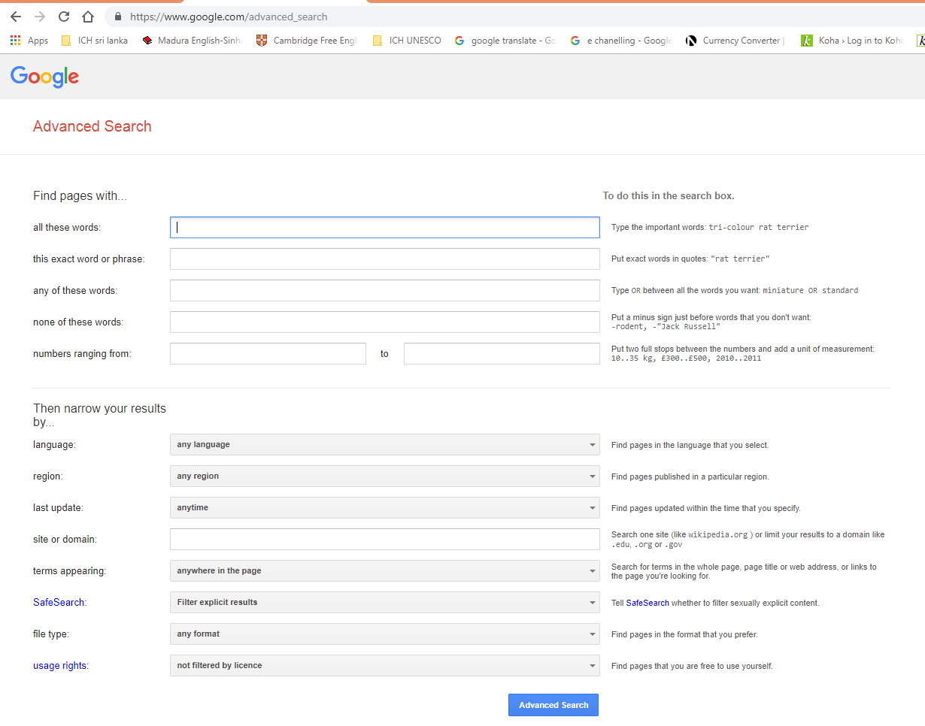
Advance search

